Slide 1
Evaluation of sea ice segmentation with manually validated images
Daniel Watkins
March 2025

Slide 2
Goals
Article to be published in IEEE Transactions on Geoscience and Remote Sensing
Dataset to be published on Zenodo and/or Brown Digital Repository
Determine using the dataset what measures are best suited for evaluating the segmentation quality
Dataset and measures to be used in calibration and validation paper

Slide 3
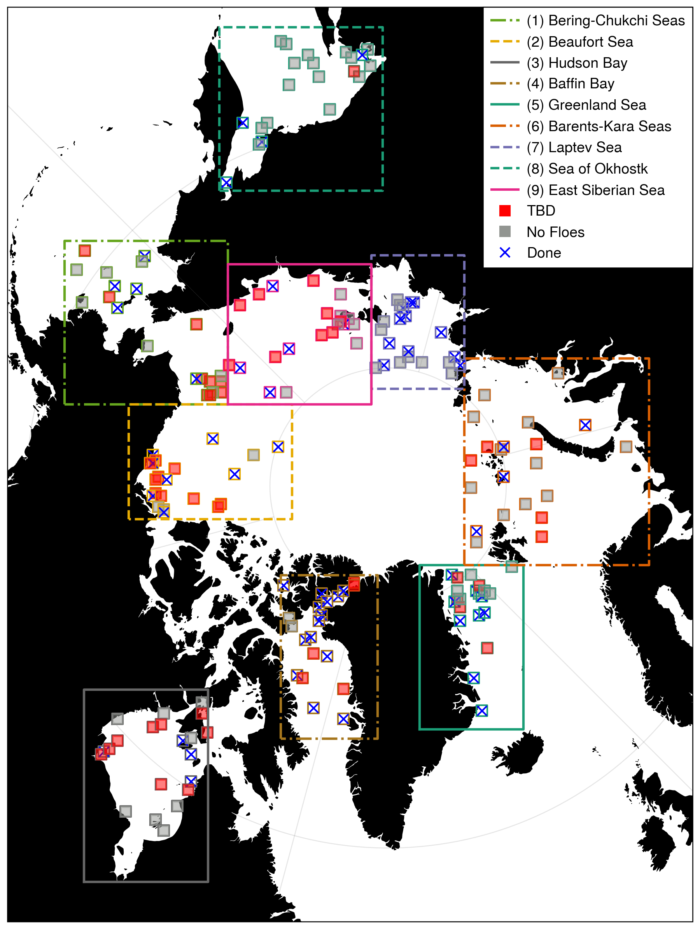
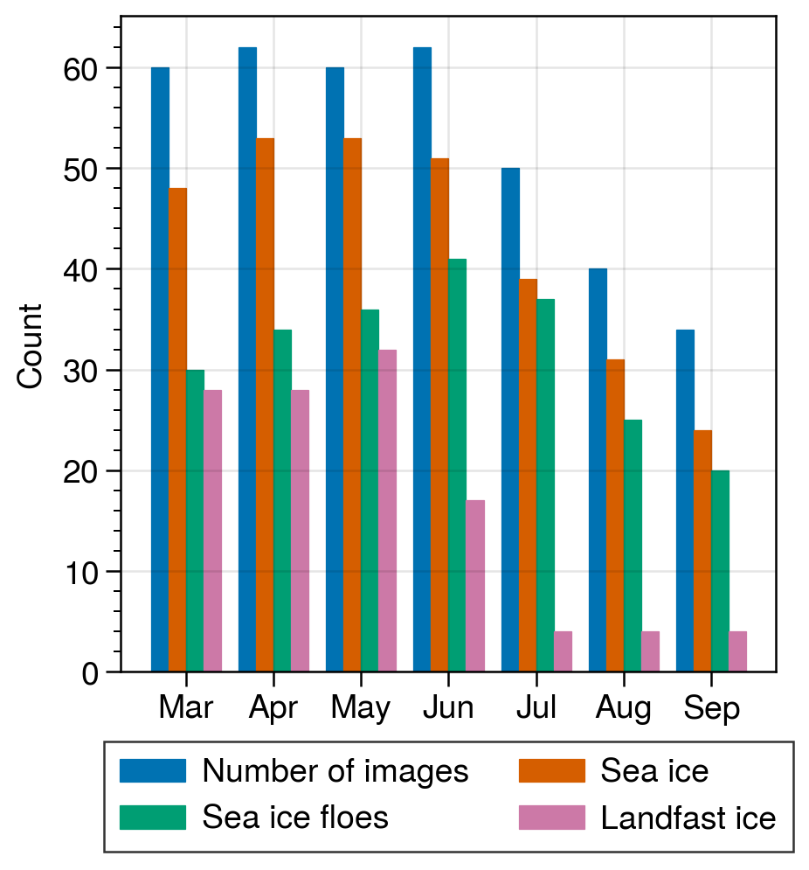
Preparation of the validation dataset
Iterative random sampling process
Stratified sample over time period with sea ice, years 2006-2023
Center point selected from NSIDC Climate Data Record pixels with sea ice between 15-85%
MASIE used to verify sea ice area fraction – if 0, new sample is drawn
100 km by 100 km MODIS images from both Aqua and Terra
378 images in total
2 satellites X 7 summer months X 3 samples per month
Sample metadata
Est. and calculated cloud fraction
(Y/N) sea ice, sea ice floes, landfast ice
Binary manual labeling of ice floes, landfast ice, landmask
Photoshop files saved to enable inspection and simple edits
Semi-automated floe pairing
Optical flow method with manual verification
Above: Simple statistics from image metadata. Right: Progress toward manual floe labeling.

Slide 4

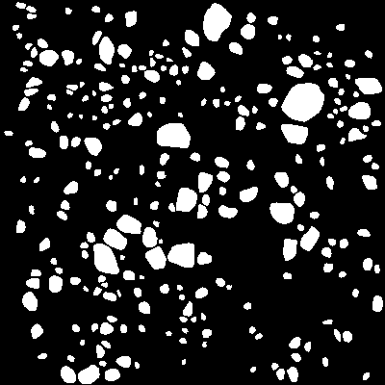



Validation dataset contents
truecolor
falsecolor
cloudfraction
landmask
floe mask
landfast
Case 166
Laptev Sea
Case 056
Beaufort Sea
True color, false color, landmask, and 5 km resolution cloud fraction saved for each case
Cloud fraction is a different resolution, but is arranged on the same snapshot data used for the true/false color data
Binary land, floe, and fast ice masks created for all the images where the metadata analysis says ice floes are present
Blank PNG files for cases with no land or landfast ice, for ease of use when compositing the masks for visualization

